Slide 1
IBM (International Business Machines)
Brielle Luft, Karli Mathis, Taylor Aitchison, Kara Keigan Cody Soeder

Slide 2
Background
-Founded in 1911 as Computing Tabulating Recording Company
-Was a result of a merger of 3 different companies
-IBM is a multinational technology and consulting corporation based in Armonk, New York

Slide 3
Background
-Produce and market computer software and hardware
-Also offers consulting services from computers to nanotechnology
-Nicknamed “Big Blue” because of it’s blue logo, letters, and uniforms

Slide 4
Background
-Forbes magazine ranked IBM as 4th most valuable brand in the world
-IBM receives 5,000 patents each year
-Top inventions include: ATM, hard disk dirve, magnetic stripe card, relational databases and the UPC

Slide 5
Macro-Environmental Forces
-Competitors
-Different Demographics
-Government regulations
-Inflations

Slide 6
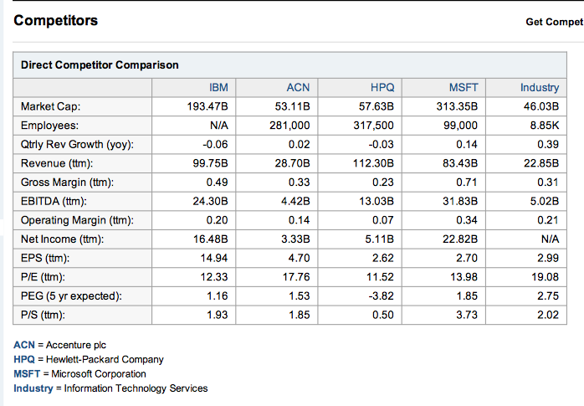
Main Competitors

Slide 7
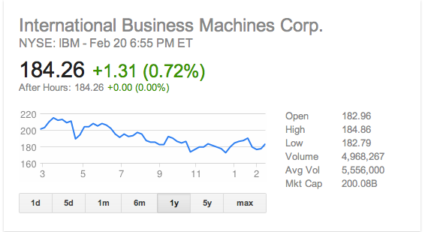

Slide 8
Question 1
What is IBM’s “Smarter Planet” business strategy? How does this strategy relate to IBM’s mission and values?

Slide 9
Business Strategy
IBM’s “Smarter Planet” strategy is based on the idea that the next major revolution in the global marketplace will move the world’s organizations toward using equipment developments that generate unprecedented amounts of data.
Therefore, they will collect data from industries such as banking, energy, health care and retailing to help businesses be more efficient, productive, and responsive.

Slide 10
Relation to Mission and Values
IBM’s values and mission both focus on customer relationships and being a leader in the industry’s most advanced internet technologies.
Their business strategy reflects this because it is their goal to ensure that businesses will become more efficient, productive and responsive by using IBM’s most advanced technologies.

Slide 11
Question 2. IBM SWOT Analysis
Weaknesses
* IBM has over 400,000 employees. It’s globalized size can make it difficult to communicate to customers’ needs right away.
* Not very affordable. The hardware is expensive.
* Products such as hard disk drives and PCs are becoming commodities and are not as customizable.
* After the mission statement, strategy and values are determined, employees need to create detailed plans for accomplishing them.
* The advanced technology can make it difficult for all customers to understand the harwareat times.
Strengths
* Leading developer of new business technologies
* One of the most valuable brands and most profitable in the world
* Very clear and crisp mission statement
* Facilitated online discussions among 50,000 employees with their key planning process.
*Strong financial position
*New technologies and patents

Slide 12
SWOT Analysis cont’d..
Opportunities
* Increased globalization is a significant opportunity that IBM can exploit in order to balance the variations in different economies.
* Their growth markets such as Africa, China, India and Brazil.
* Smarter computing and cloud
* Business analytics and optimization
* Connectivity
Threats
* Demand for Smarter Planet solutions will depend on interest in charge rather than just reaction
*Conversion to custom-made technological solutions.
*Exhibiting success will require a precise and timely measurement of significant outcomes

Slide 13
What are the relevant trends to consider for the next three to five years?
Customer Trends
o Desire for a “globally integrated enterprise.”
o Desire for “connectivity across technologies.”
o Desire for “customized technological solutions.”
External Trends
* Increasingly quick access to world wide web
* Advance in rising economies
* Fewer global transportation/trade barriers

Slide 14
Question 3
How can IBM communicate its strategy to companies, cities, and governments?

Slide 15
Communicate Strategies
Proper Advertisements(Personal Connections)
Being adaptable (Versatility is key)
Personal approach
Monopoly (Innovative)
Being an individual (focusing on the clients instead of profits)
Create Partnerships
Be beneficial for the communities, Cities, Governments.

Slide 16
Question 4
What are the benefits of the Smarter Planet initiative to (a) society and (b) IBM?

Slide 17
a.) Benefits with society
Made banking easier with the ATM
Saved billions of dollars by saving water
Helped with traffic congestion
Helped with the wastage of food
b.) How IBM has benefitted
Opened up over 400,000 jobs for people in over 200 countries
The leading developer of new business technologies
Forbes magazine named IBM the fourth most valuable brand in the world

Slide 18
Question 5
How should IBM measure the results of the Smarter Planet strategy?
Getting feedback from the customers, companies, cities and governments they have been in contact with by sending out surveys via email
This will keep us better connected to the clients
Also, by using their own smart systems to analyze their own data, increasing the efficiency of the results

Slide 19
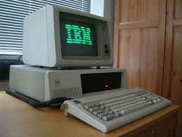
The End….
IBM

